Slide 1
Parallel and Distributed Computing
CS3006
Lecture 11
Basic Communication Operations

Slide 2
Basic Communication Operations
Notes:
Permute the matrix→ use 2d block distribution

Slide 3
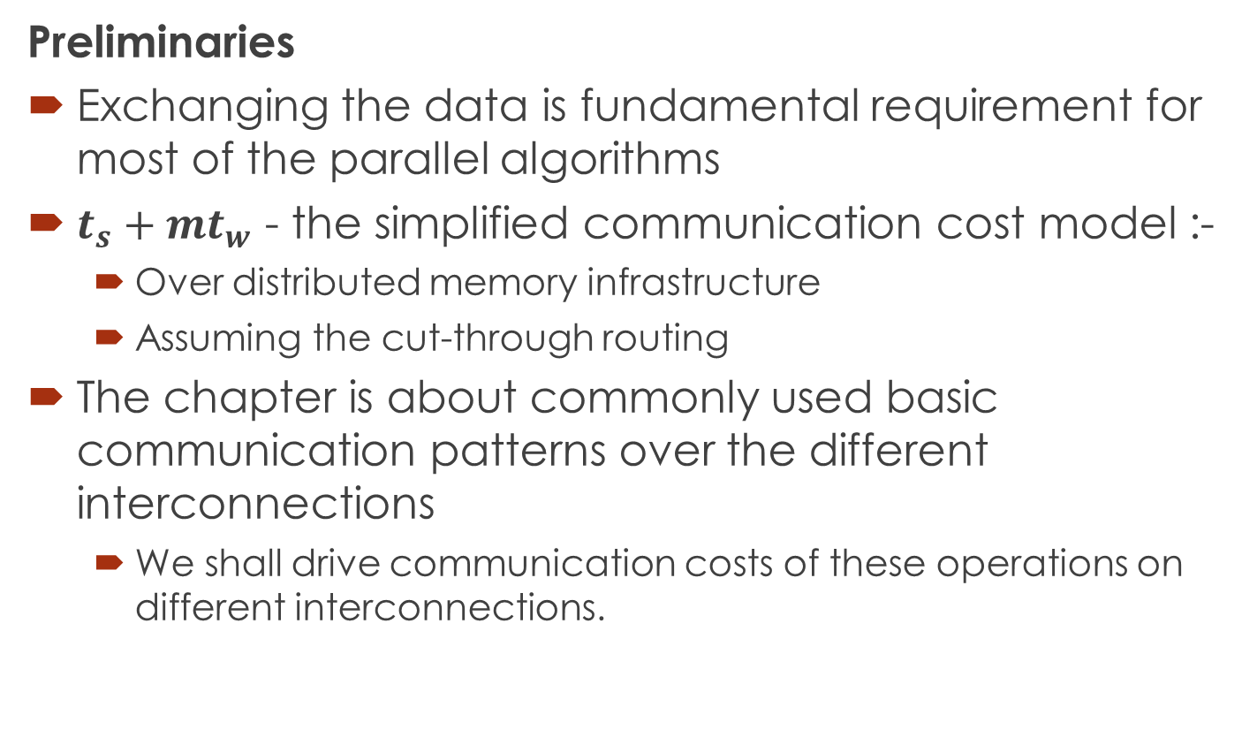
Basic Communication Operations
Preliminaries
Exchanging the data is fundamental requirement for most of the parallel algorithms
$t_{s}+mt_{w}$ - the simplified communication cost model :-
Over distributed memory infrastructure
Assuming the cut-through routing
The chapter is about commonly used basic communication patterns over the different interconnections
We shall drive communication costs of these operations on different interconnections.
Notes:
Some interconnections are only for pedagogical(teaching) reasons. Because learning linear arrays make it easy to understand communication patterns in other interconnections

Slide 4
Basic Communication Operations
Assumptions for the Operations
Interconnections support cut-through routing
Communication time between any pair of nodes in the network is same (regardless of the number of intermediate nodes)
Links are bi-directional
The directly connected nodes can simultaneously send messages of m words without any congestion
Single-port communication model
A node can send on only one of its links at a time
A node can receive on only one of its links at a time
However, a node can receive a message while sending another message at the same time on the same or a different link.
Consider p=2^{i} nodes

Slide 5
One-to-All Broadcast and All-to-One Reduction
Notes:
Permute the matrix→ use 2d block distribution

Slide 6
Basic Communication Operations (One-to-All Broadcast and All-to-One Reduction)
One-to-All Broadcast
A single process sends identical data to all other processes.
Initially one process has data of m size.
After broadcast operation, each of the processes have own copy of the m size.
All-to-One Reduction
Dual of one-to-all broadcast
The m-sized data from all processes are combined through an associative operator
accumulated at a single destination process into one buffer of size m
Notes:
Applications: vector-matrix multiplication, shortest paths calculation, and inner vector product.

Slide 7
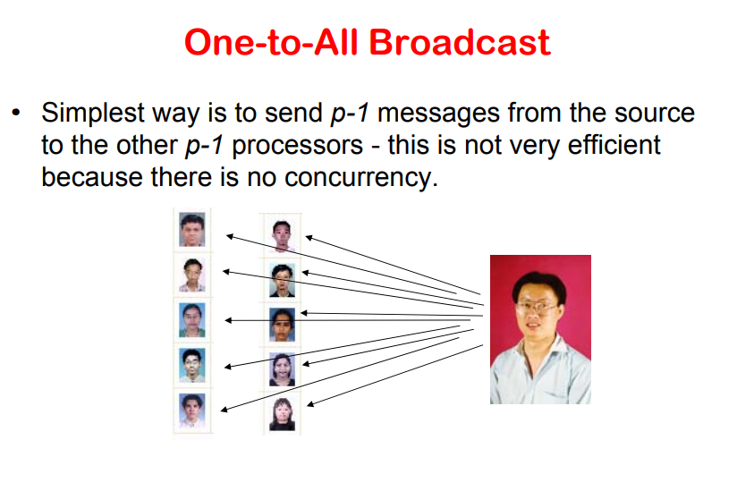

Slide 8
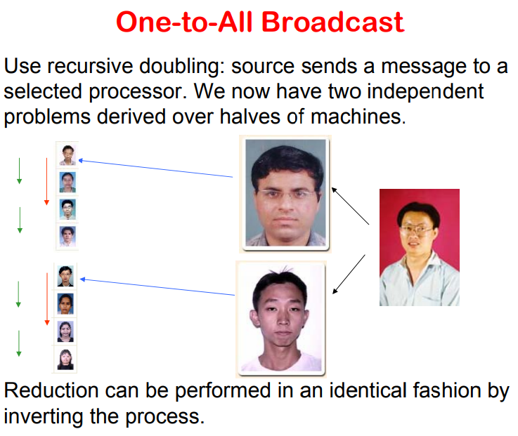

Slide 9
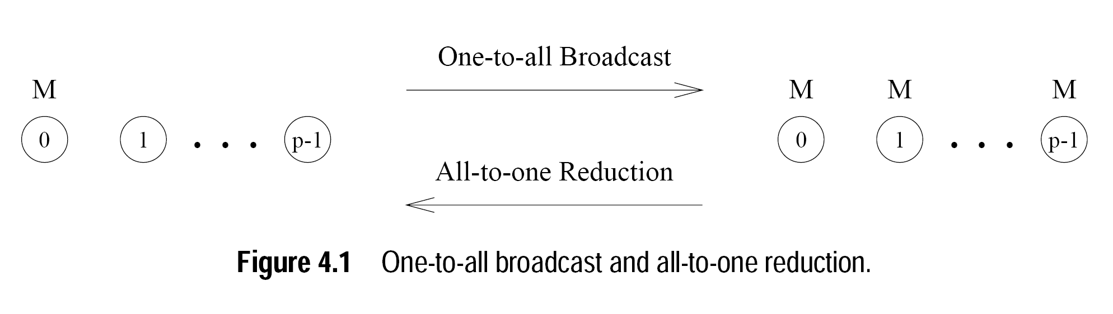
Basic Communication Operations (One-to-All Broadcast and All-to-One Reduction)
Notes:
Applications: vector-matrix multiplication, shortest paths calculation, and inner vector product.

Slide 10
Basic Communication Operations (One-to-All Broadcast and All-to-One Reduction)
Linear Array or Ring
Naïve solution
sequentially send p - 1 messages from the source to the other p - 1 processes
Bottle necks, and underutilization of communication network
Solution?
Recursive doubling
Source process sends the massage to another process
In next communication phase both the processes can simultaneously propagate the message

Slide 11
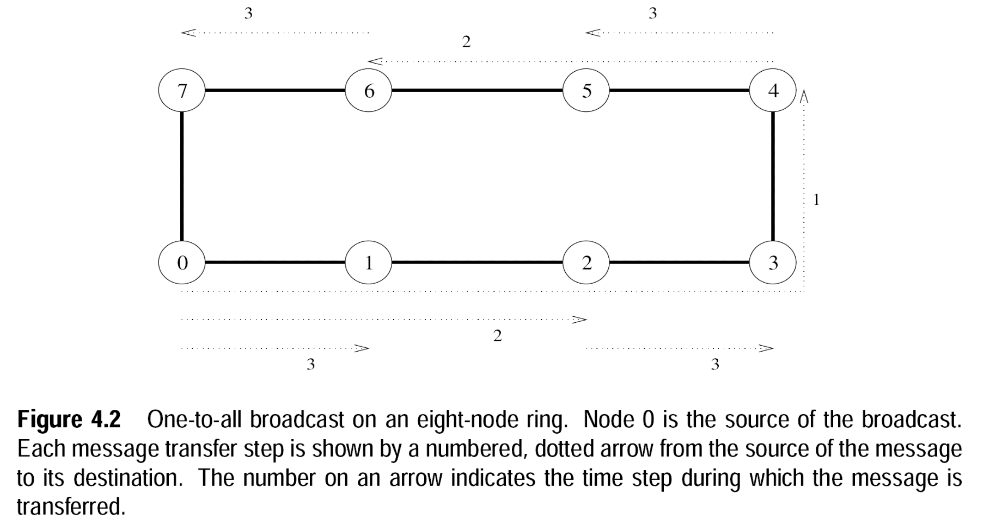
Basic Communication Operations (One-to-All Broadcast and All-to-One Reduction)
Linear Array or Ring
Recursive Doubling Broadcast
Notes:
Select destination such that no congestions occur

Slide 12
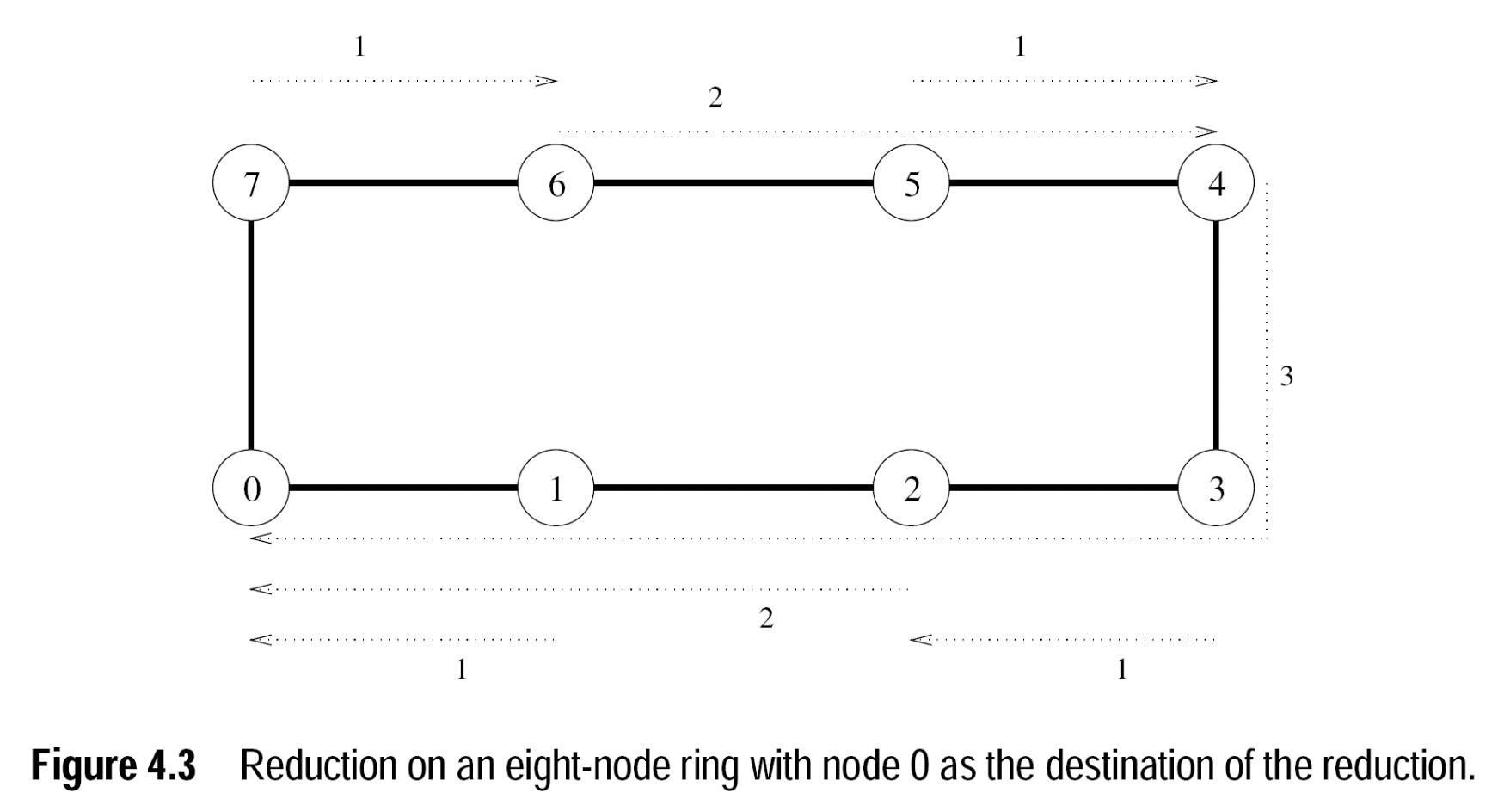
Basic Communication Operations (One-to-All Broadcast and All-to-One Reduction)
Linear Array or Ring
Recursive Doubling Reduction
Notes:
Odd will send message to even and associative operator will combine the results

Slide 13
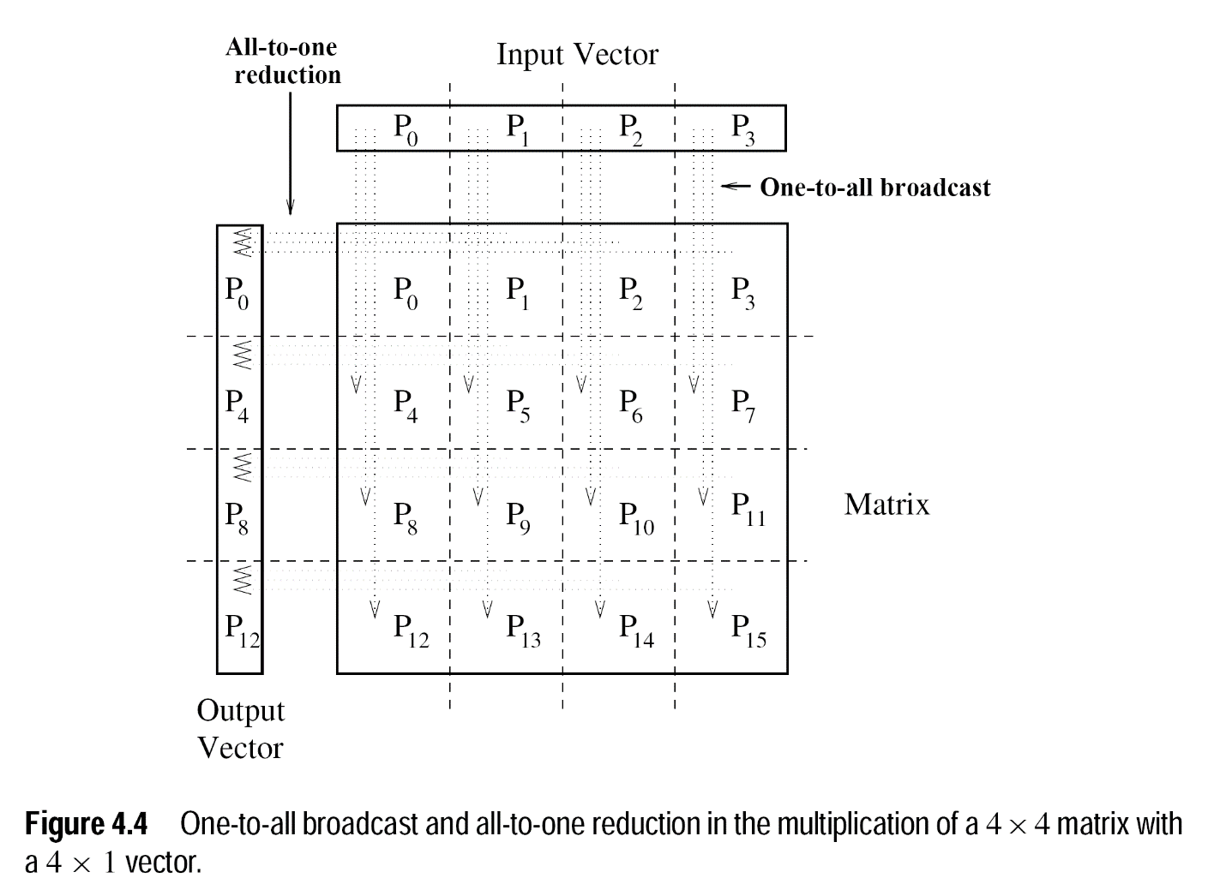
Basic Communication Operations (One-to-All Broadcast and All-to-One Reduction)
Matrix-Vector Multiplication (An Application)
Notes:
Odd will send message to even and associative operator will combine the results

Slide 14
Basic Communication Operations (One-to-All Broadcast and All-to-One Reduction)
Mesh
We can regard each row and column of a square mesh of p nodes as a linear array of nodes
Communication algorithms on the mesh are simple extensions of their linear array counterparts
Broadcast and Reduction
Two step breakdown:
The operation is performed along one by treating the row as linear array
Then the all the columns are treated similarly

Slide 15
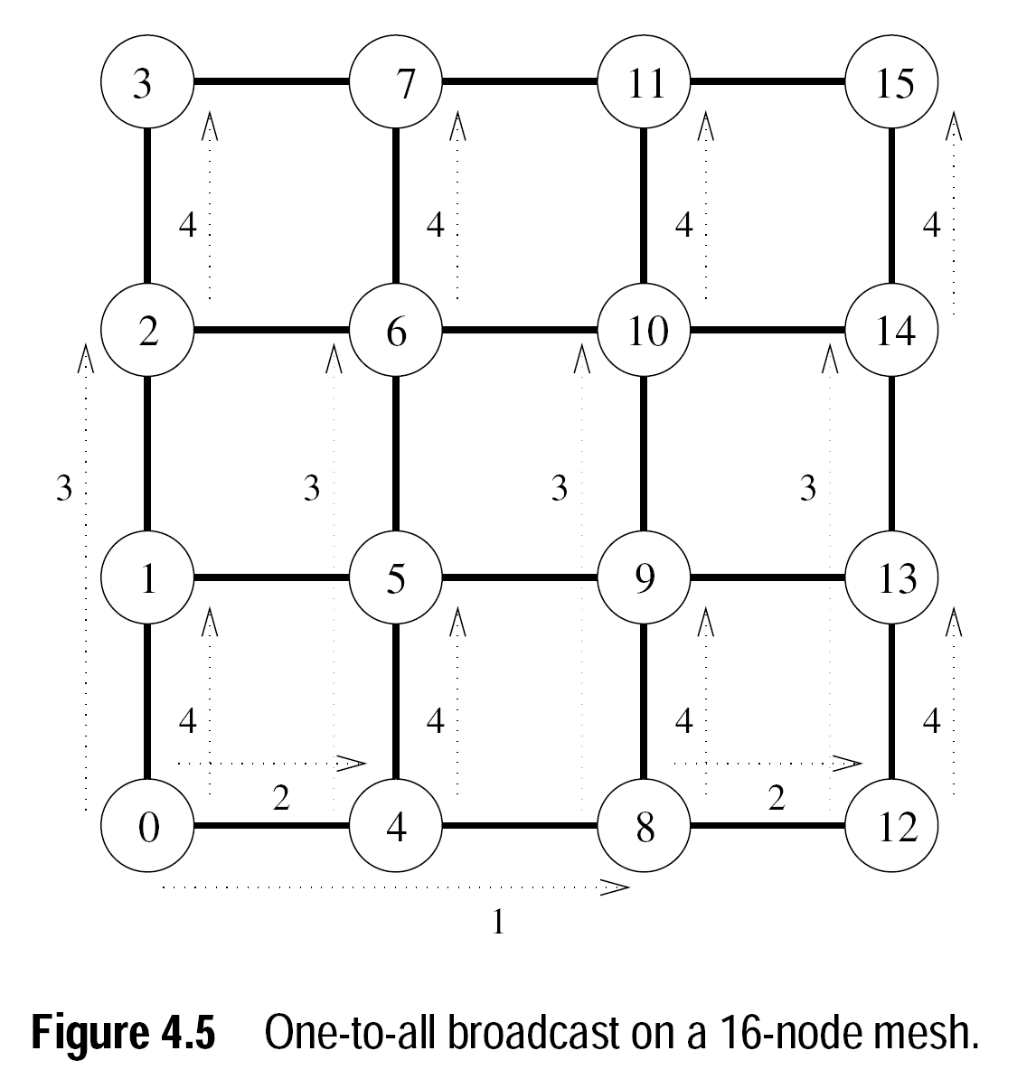
Basic Communication Operations (One-to-All Broadcast and All-to-One Reduction)
Mesh (Broadcast and Reduction)
Notes:
What about three dimensional mesh?

Slide 16
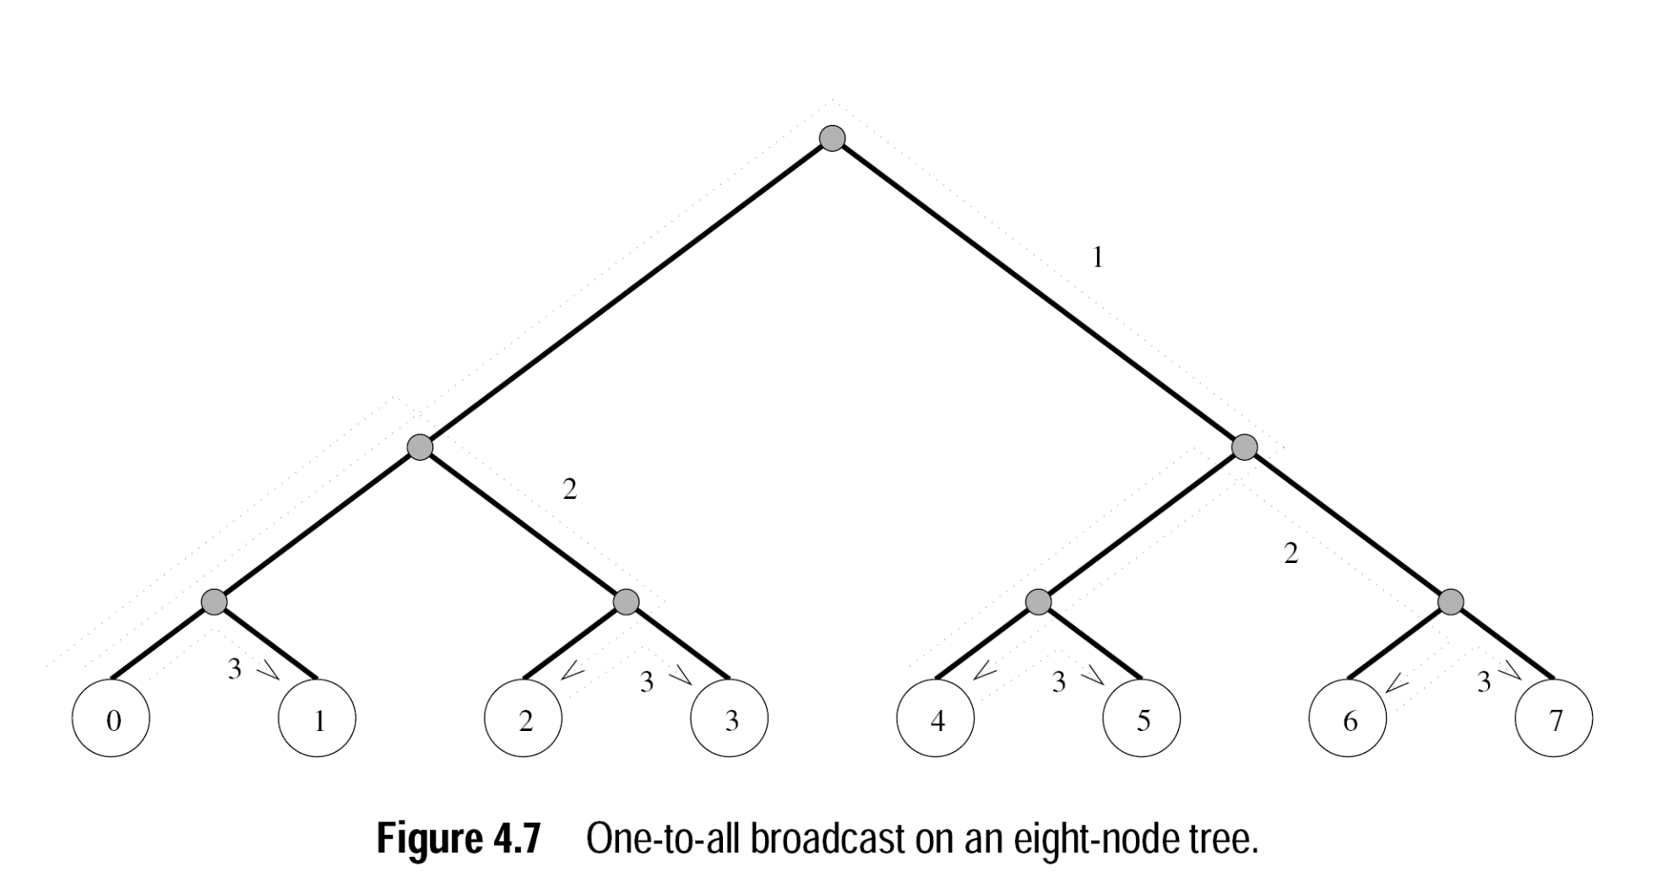
Basic Communication Operations (One-to-All Broadcast and All-to-One Reduction)
Balanced Binary Tree
Broadcast
Notes:
Hypercube algorithm without any changes.

Slide 17
Basic Communication Operations (One-to-All Broadcast and All-to-One Reduction)
Hypercube
Broadcast
Source node first send data to one node in the highest dimension
The communication successively proceeds along lower dimensions in the subsequent steps
The algorithm is same as used for linear array
But, here changing order of dimension does not congest the network

Slide 18
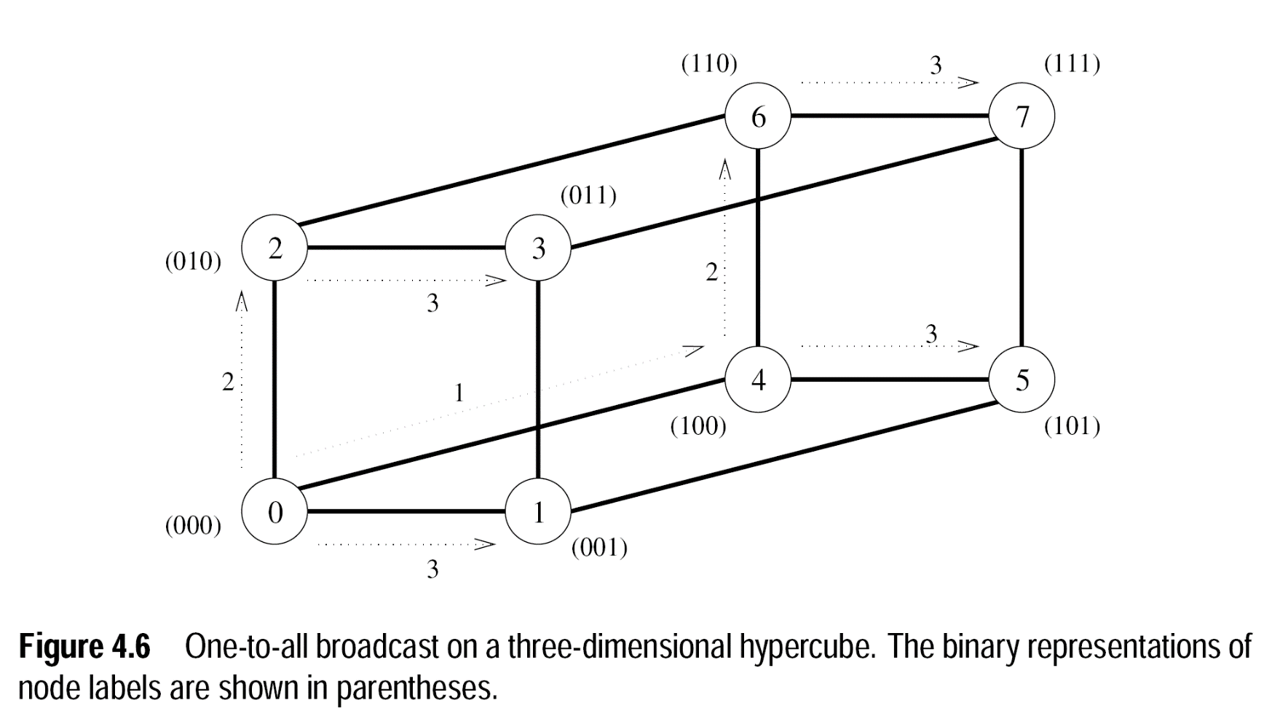
Basic Communication Operations (One-to-All Broadcast and All-to-One Reduction)
Hypercube
Broadcast

Slide 19
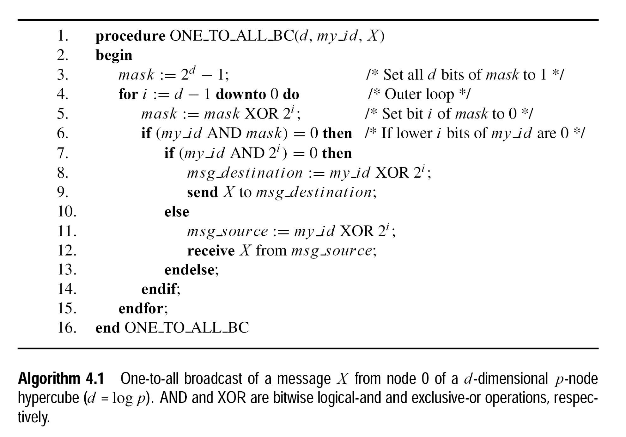
Basic Communication Operations (One-to-All Broadcast and All-to-One Reduction)
Hypercube
Broadcast(Algorithm)
Notes:
6) id AND mask==0 → if I will be in communication in this step (if my i bits are zero)
7) Id AND 2i ==0 → if I’m the sender of message (if my i+1th bit is 0)
8) Xoring id with 2i gives my partner in ith phase of the algorithm

Slide 20
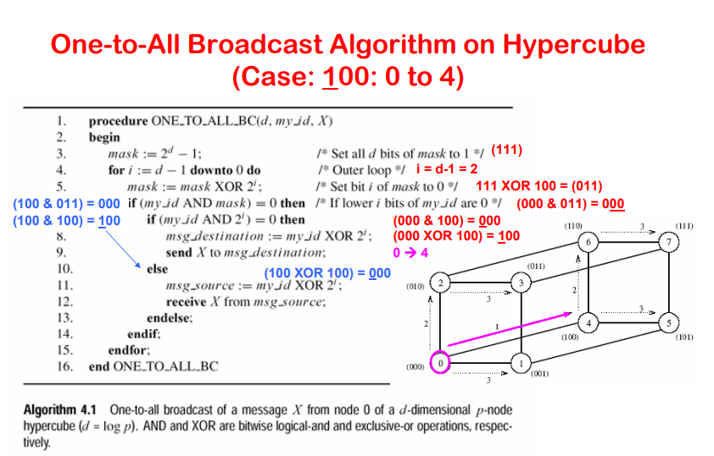

Slide 21
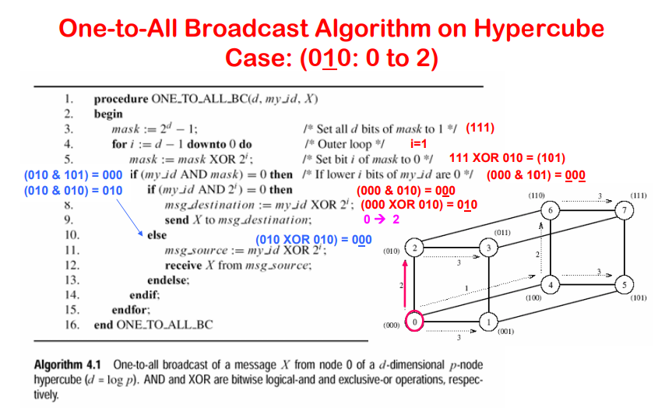

Slide 22
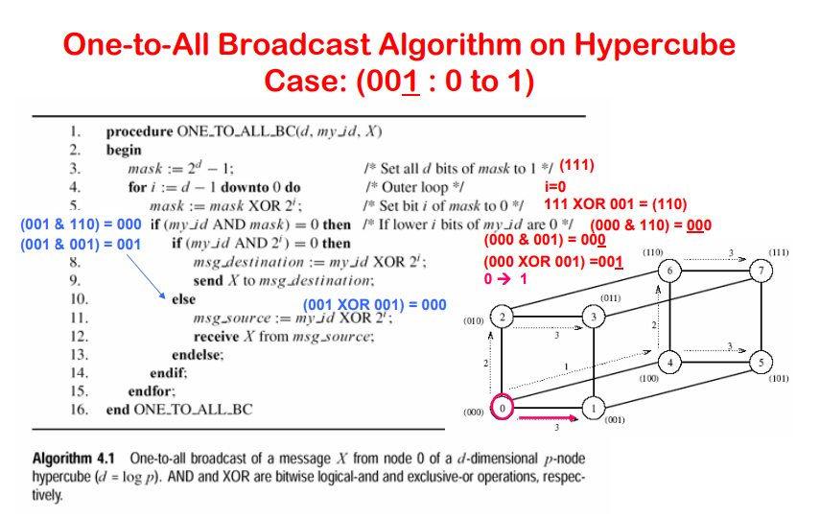

Slide 23
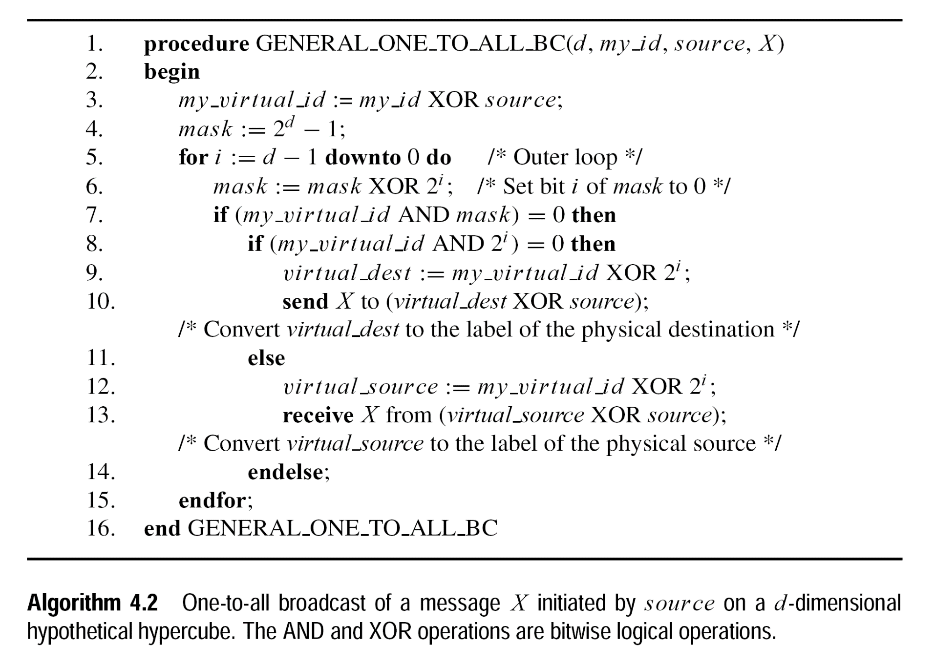
Basic Communication Operations (One-to-All Broadcast and All-to-One Reduction)
Hypercube
Broadcast(Algorithm)
Notes:
source XOR source makes source→ zero and similarly maps other according to the source

Slide 24
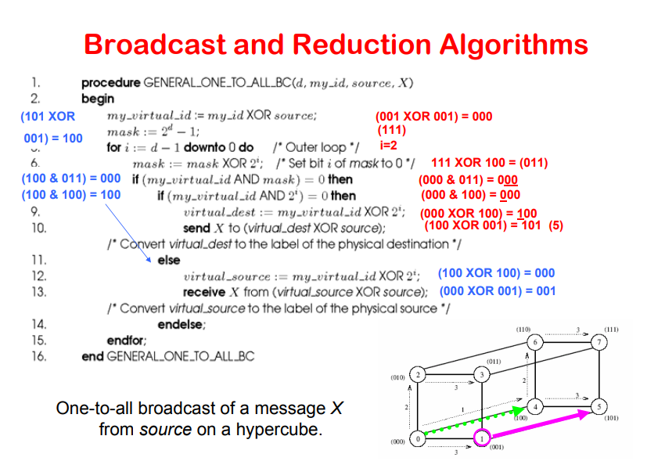

Slide 25
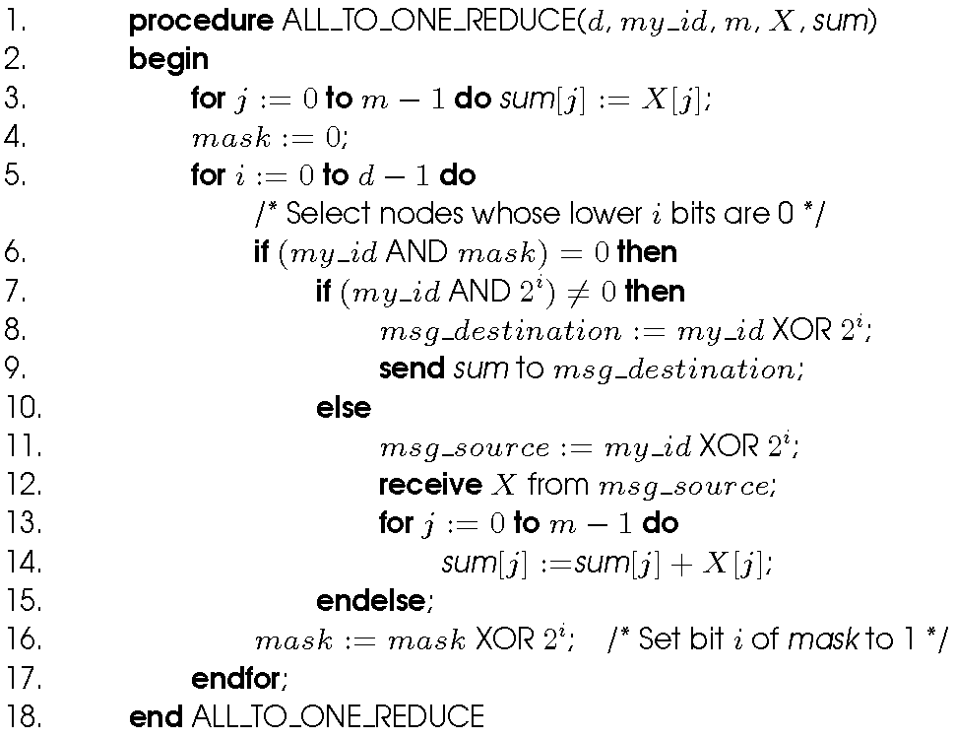
Basic Communication Operations (One-to-All Broadcast and All-to-One Reduction)
Hypercube
Broadcast(Algorithm)
Notes:
Assigned reading

Slide 26
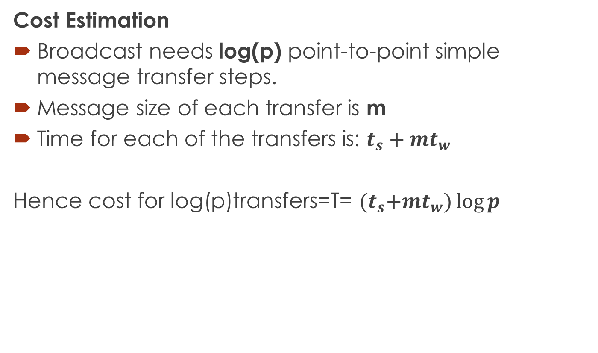
Basic Communication Operations (One-to-All Broadcast and All-to-One Reduction)
Cost Estimation
Broadcast needs log(p) point-to-point simple message transfer steps.
Message size of each transfer is m
Time for each of the transfers is: $t_{s}+mt_{w}$
Hence cost for log(p)transfers=T= ${(t}_{s}+mt_{w})\log{p}$
Notes:
Assignment#2:

Slide 27

Questions

Slide 28
References
https://www.cs.purdue.edu/homes/ayg/book/Slides/
https://phyweb.physics.nus.edu.sg/~phytaysc/cz4102_07/cz4102_le6.pdf

